Slide 1
CSS Grid - Introduction
Grid is a two-dimensional layout system allowing precise placement of items in rows and columns.

Slide 2
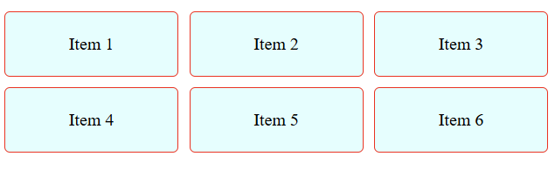
Grid Container Properties
.container {
display: grid;
grid-template-columns: repeat(3, 1fr);
grid-gap: 10px;
}
<div class="container">
<div class="item">Item 1</div>
<div class="item">Item 2</div>
<div class="item">Item 3</div>
<div class="item">Item 4</div>
<div class="item">Item 5</div>
<div class="item">Item 6</div>
</div>
view

Slide 3
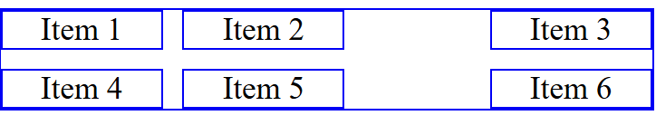
Basic Grid Layout
.container {
display: grid;
grid-template-columns: 1fr 2fr 1fr;
}
<div class="container">
<div class="item1">Item 1</div>
<div class="item2">Item 2</div>
<div class="item3">Item 3</div>
<div class="item4">Item 4</div>
</div>
view

Slide 4
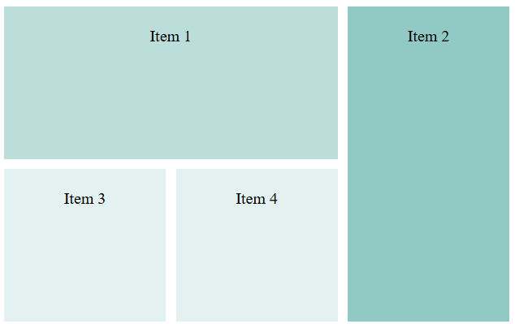
Grid Item positioning
.container {
display: grid;
grid-template-columns: repeat(3, 1fr);
grid-template-rows: repeat(2, 150px);
gap: 10px;
}
.item1 {
grid-column: 1/3;
grid-row: 1/2;
}
.item2 {
grid-column: 3/4;
grid-row: 1/3;
}
<div class="container">
<div class="item1">Item 1</div>
<div class="item2">Item 2</div>
<div class="item3">Item 3</div>
<div class="item4">Item 4</div>
</div>
view

Slide 5
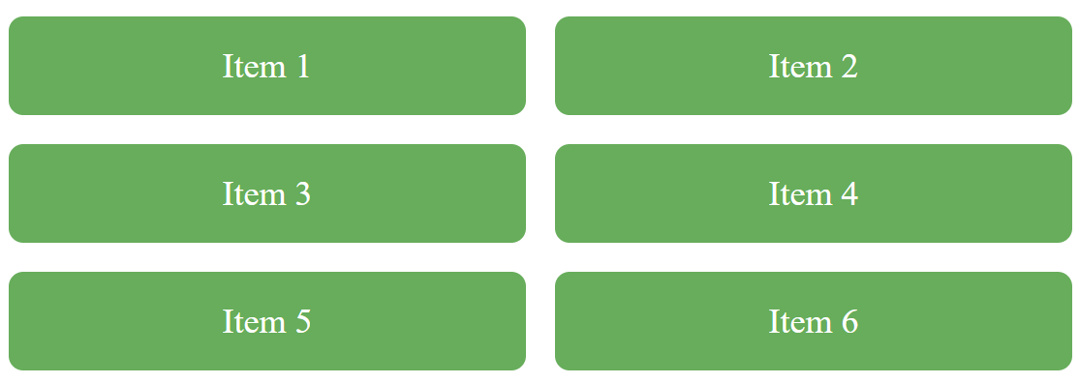
Responsive Grid Gallery
Each column should be at least 200px wide, but if there is more room, let it expand and share space equally.
Below shows what happens when display shrinks.
.container {
display: grid;
grid-template-columns: repeat(auto-fit, minmax(200px, 1fr));
gap: 1rem;
}
view

Slide 6
Stacking Containers
.grid {
display: grid;
grid-template-columns: repeat(auto-fit, minmax(250px,1fr));
}
@container (min-width: 400px) {
.card-content {
flex-direction: row;
}
}
💡 Cards adapt independently when container width passes 400px.
demo

Slide 7
Responsive SPA Grid
💡 Sidebar stacks below content on smaller screens.
.app {
display: grid;
grid-template-areas: 'sidebar content';
grid-template-columns: 200px 1fr;
}
@media (max-width: 800px) {
.app {
grid-template-areas: 'content' 'sidebar';
}
}
view

Slide 8
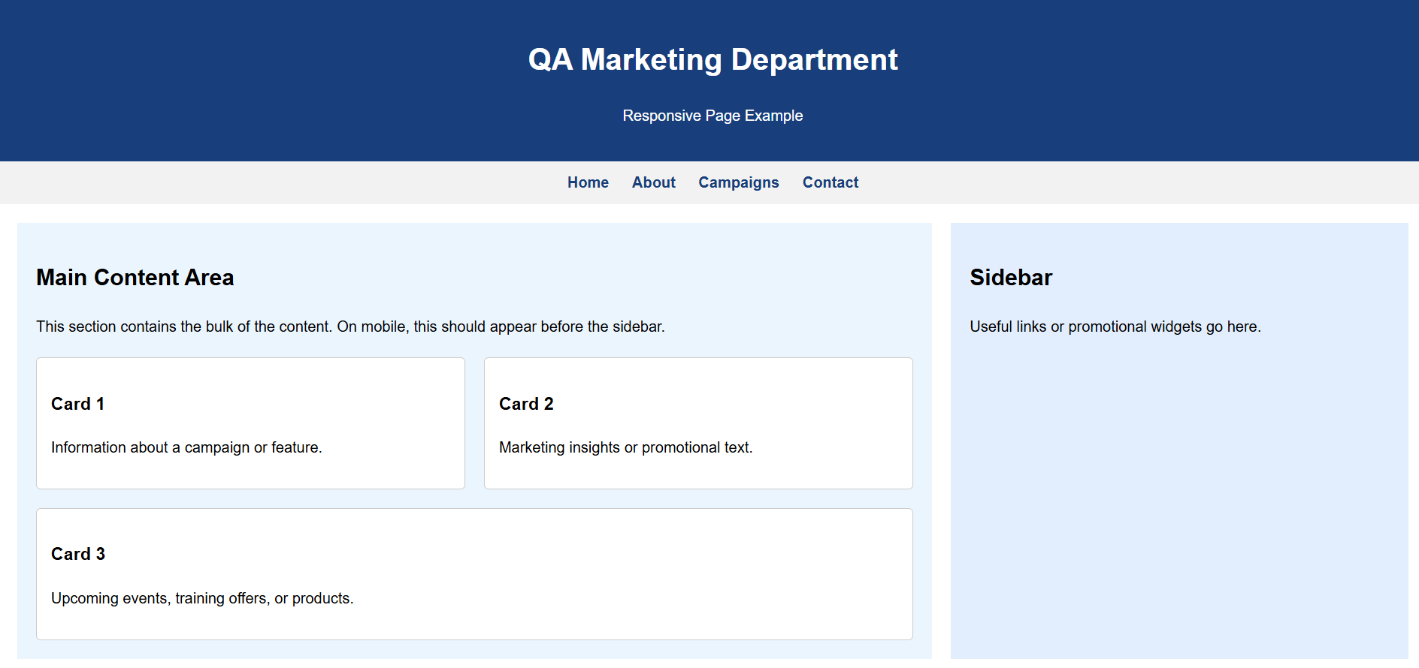
Lab - Combined Layout
Create a page as seen below Header: Flexbox - Main section: Grid with sidebar and content Footer: Flex with centered text and icons
Use media queries for mobile responsiveness.

Slide 9
Summary
In this chapter, you discovered how to use Grids to create a Responsive web page

